Slide 1
Laboratory Safety Equipment
Lab coat
Safety glasses
Disposable gloves
Closed shoes
Brain!

Slide 2
Risks – part 1
Chemical hazard - Resin and crosslinker are irritants (safety glasses, lab coat, gloves, shoes)
Skin & Eyes – alert teacher – wash affected area immediately
Avoid spills
Small spills – wipe (gloves, coat and glasses)
Large spills – alert teacher

Slide 3
Risks – part 1
Report all incidents
Don’t touch face, paper, pens etc. with gloes
Dispose of gloves safely
No eating/drinking in the lab!

Slide 4
Risks – part 2
Apparatus tension
Weights falling
Slip, trip, fall

Slide 5
What was the experiment about?
Production and mechanical properties of formulated elastomers
Aim: to make some elastomer materials with and without additives
and measure their Young’s modulus
Objectives:
To prepare samples of polydimethylsiloxane, with and without additives (coloured dyes or particles)
To complete a thorough risk assessment prior to the practical work
To research the name and structures of all reactants and products
To research the mechanism of the reaction
To write a short report about the experiment

Slide 6
Report
Names and structures of reactants and products
Discussion of reaction
Reaction equations
Reaction mechanism
Observations
Risk assessment

Slide 7
Report:
How should you write the report?
The group will write a report on the data you have collected
The report will compare the Young’s modulus of your samples
with and without the additive
Are they different or not?

Slide 8
Report:
How should you write the report?
The report will be no longer than 3 pages of A4 paper
and include the following sections:
Introduction
Methods
Results
Discussion
Conclusions

Slide 9
Report:
How should you write the report?
Title and authors:
Mechanical properties of formulated elastomers
Group X: Names of group members
Introduction:
Give the rationale for the experiment
What are you trying to find out?
What is your hypothesis?
How did you test your hypothesis?

Slide 10
Report:
How should you write the report?
Methods:
Briefly explain how you did the experiment
You do not need to repeat the instructions for the experiment
They are available on QMPlus
Give the reference to where to find them on QMPlus
Include in this section the details of your formulation
the actual weights of resin, crosslinker and additive
that you used for your samples

Slide 11
Report:
How should you write the report?
Results:
Present and describe the results
Plot 1 stress-strain graph with all the data you collected
Put all the data on 1 graph (scatter chart)
Make it clear which data are from samples with additive
and which data are from samples with no additive
(by colouring the data points or using different shaped symbols)

Slide 12
Report:
(Data from Group M9)
II
I
Plot 1 scatter chart with all the stress-strain data on it

Slide 13
Report:
Find the Young’s modulus from the slope (gradient) of
a linear fit (trendline) to each set of your data
Calculate the average the Young’s modulus values for the samples
with additive and the samples without additive
Plot a column chart for
the 2 sets of samples
to compare the result
(Data from Group M9)
I II

Slide 14
Report:
How should you write the report?
Discussion:
Tell the reader what the data shows:
Describe the scatter in the data
– do you get the same result from similar samples?
Describe the difference between the 2 types of samples
Are they different or are they the same?
Describe any observations you have about your samples
– what effect do you think the additive has on the
mechanical properties of the polymer?

Slide 15
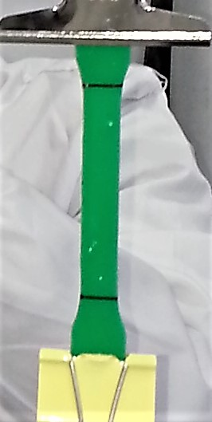
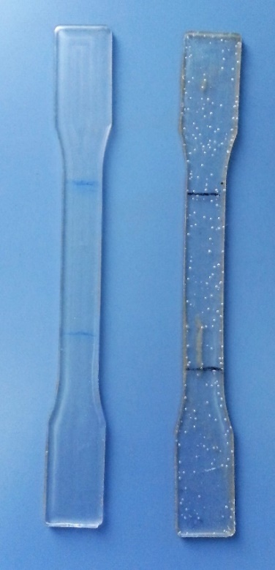
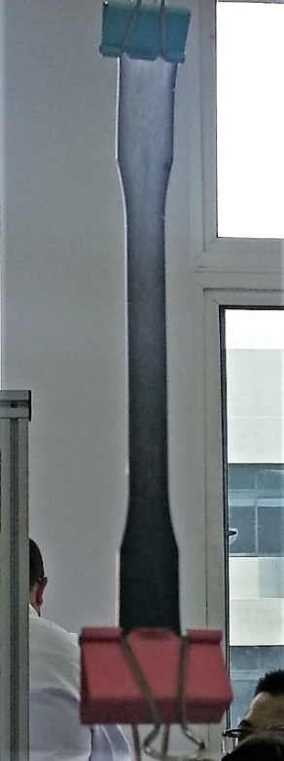
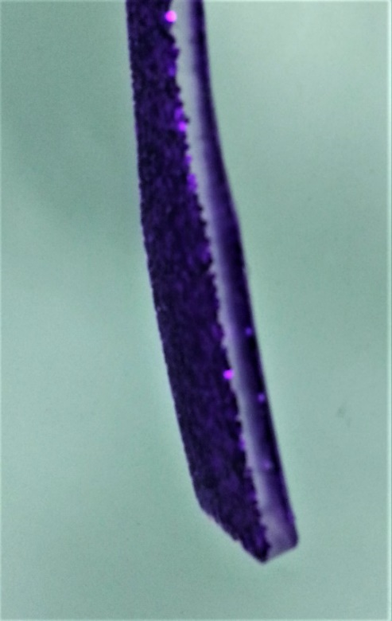
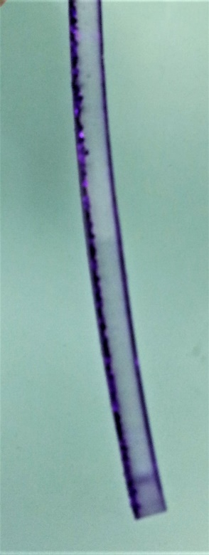
Report:
How should you write the report?
Discussion: distribution of the additive

Slide 16
Report:
How should you write the report?
Conclusions:
What can you say about the result?
Is the hypothesis true or not?
Have you been able to answer the research question?
completely?
partially?

Slide 17
Report
The report should be no more than 3 pages of A4
The group should write the report and submit it
Make sure everyone in the group contributes to the report
Make sure everyone in the group agrees the final version
e-mail your finished report as a pdf file to:
a.spowage@qmul.ac.uk
copy the e-mail to all group members
The report is worth 30% of your score for QXU4004

